Slide 1
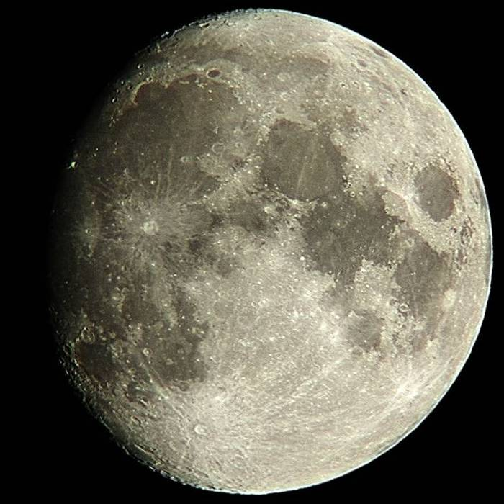
LUNAR MADNESS
&
PLANETARY THRILLS
Observing the 12 day Moon
&
6 Targets for Moonstruck
(10 ½ day Moon)
Richard Orr
October 21, 2004
Notes:
September 25th – Observations
Moonstruck on the 23rd

Slide 2
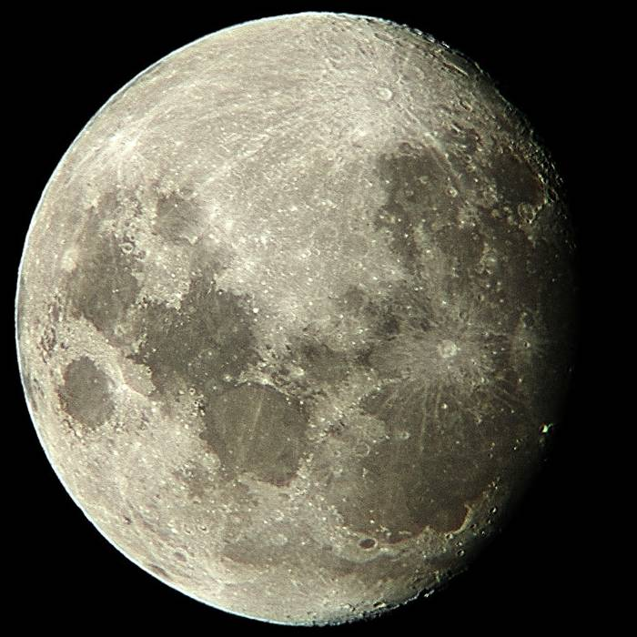
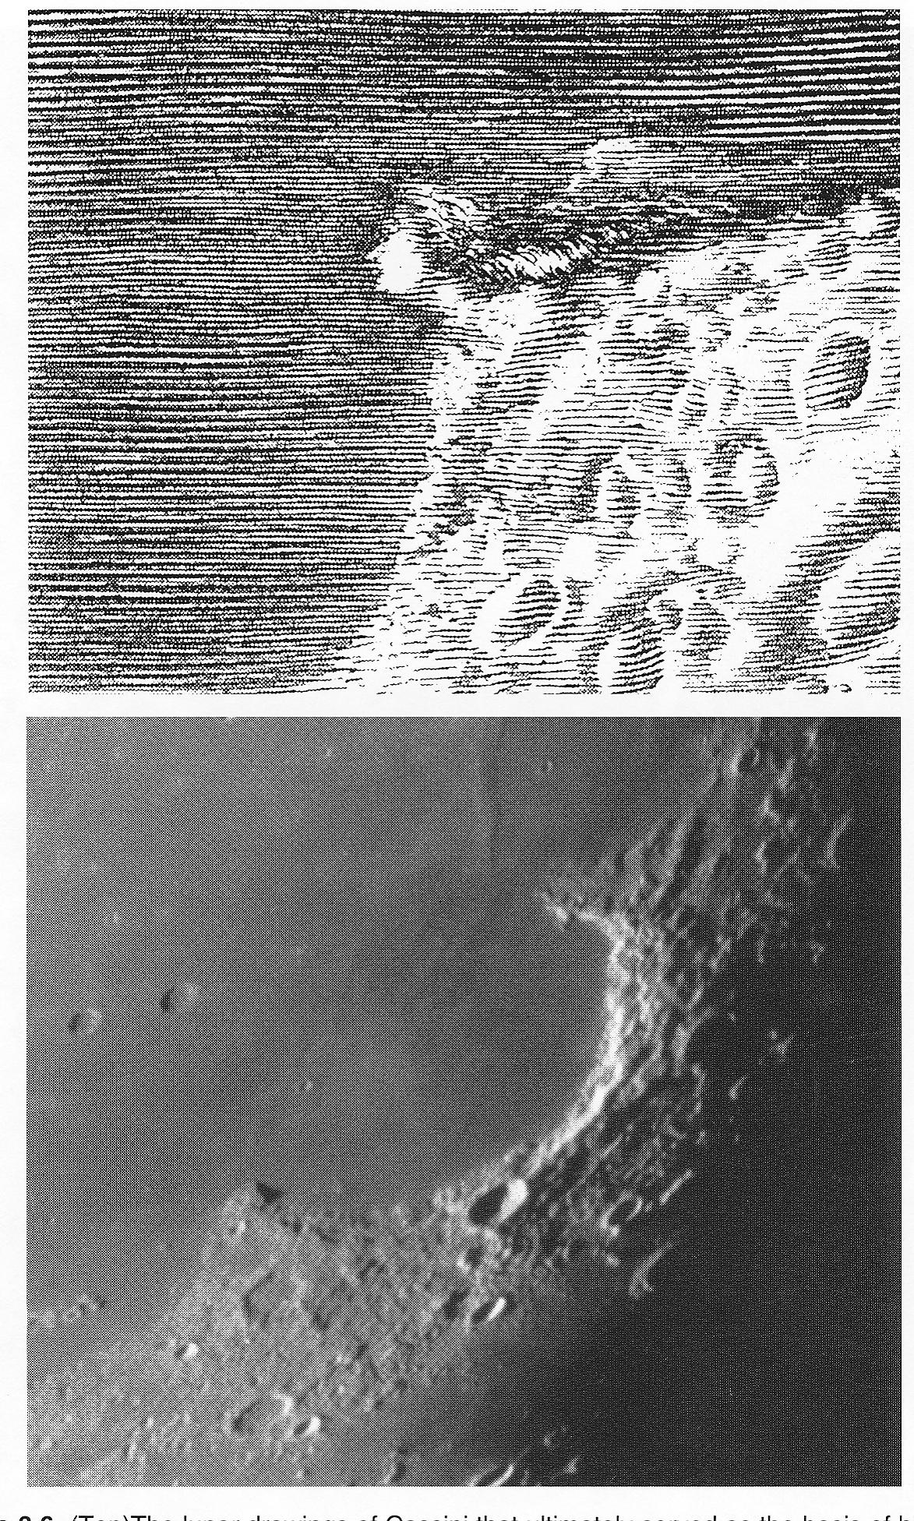
Heracleides
Promontorium
Sinus Iridum
Bay of Rainbow
Notes:
Heracleides Promontorium which looked to Cassini’s eye like a Lady’s head – greatest observational astronomer of the second half of the seventeenth century

Slide 3
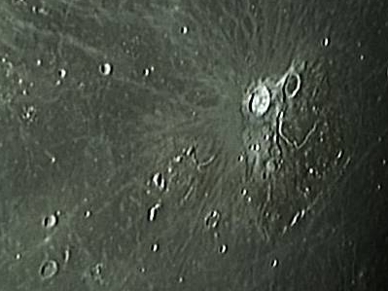
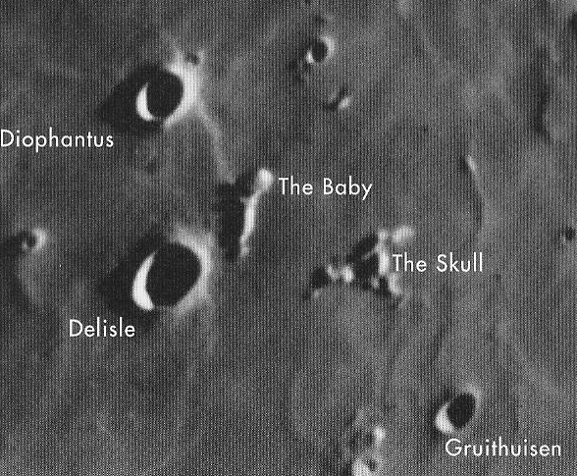
Aristarchus
Herodotus
Harbinger Mtns
Prinz
Krieger

Slide 4
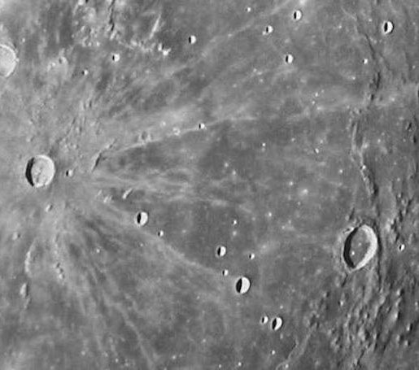
Marius Hills
Kepler
Marius

Slide 5
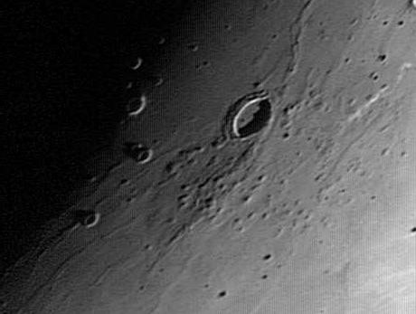
Volcanic complex – substantial root of dense unerupted magma below the surface
Approximately 300 domes or hills
Seem to be steeper & rougher than normal lunar domes – few have summit craters
Small volcanoes (cones) not domes (laccoliths)
One of the youngness sites of volcanism on the moon

Slide 6
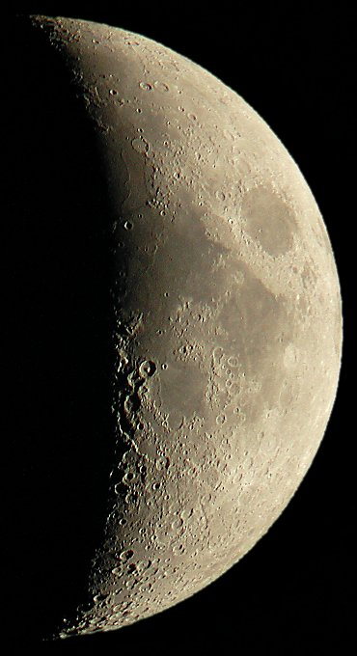
HOME WORK
Where the moon is smooth is the terminator a distinct sharp line as seen through your telescope?
No atmosphere – the sun is as bright on the horizon as overhead
But at sunrise/sunset only part of the sun is above the horizon so there is less light at different times; but can this difference be picked up by your telescope?
Hint – the effect would be greatest where the terminator crosses the seas and less pronounced in the highlands
Notes:
6 day moon

Slide 7
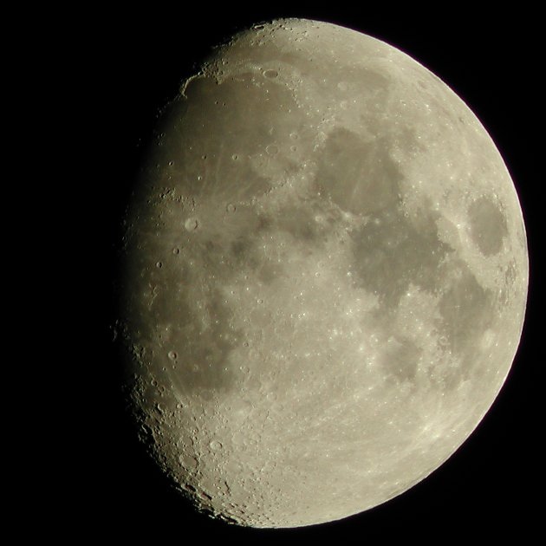
MOON-STRUCK
October 23, 2004
Ten and half day old moon
Volunteers needed for 6 viewing stations
Four telescopes at medium to high power (Stations 1, 2, 3, 5)
Two telescopes at low to medium power (whole moon view) (Stations 4 & 6)

Slide 8
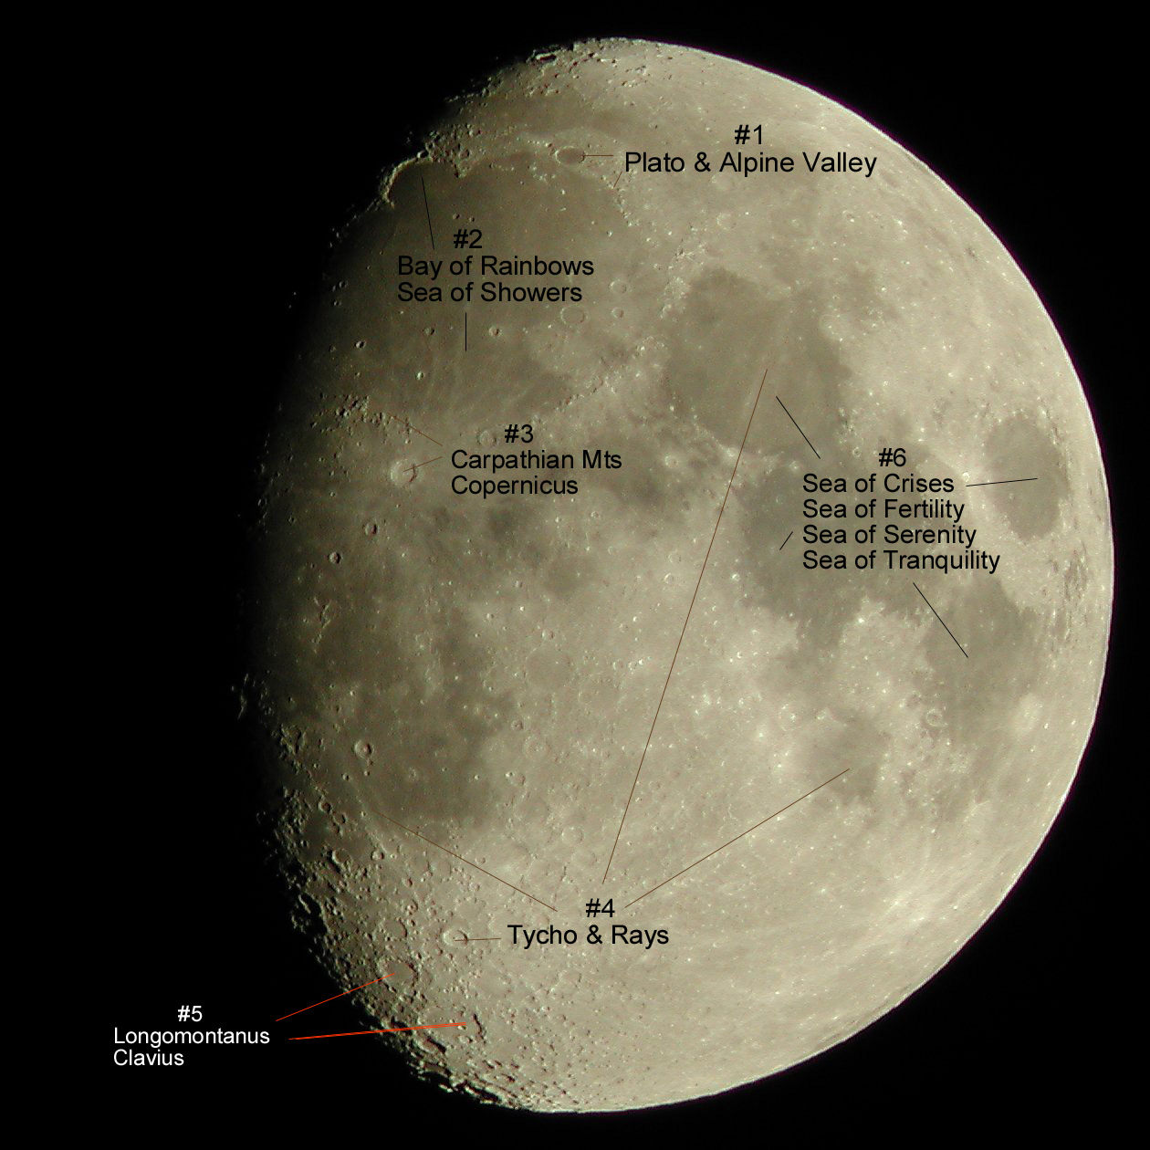
#5 Clavius

Slide 9
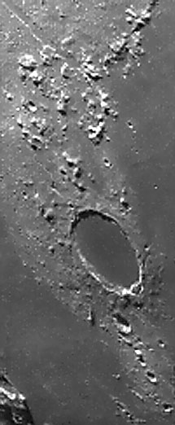
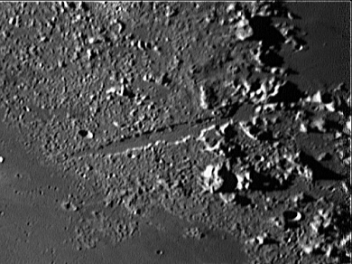
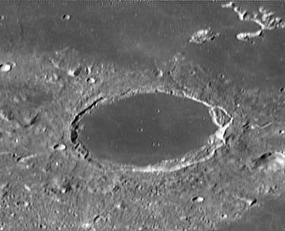
STATION #1:
Plato and the Alpine Valley
Alpine Valley – artificial looking
Cuts through the heart of the Alps
110 miles long -1 to 13 miles wide
It is a “Graben” filled with basalt not a “gouge”
Plato – 64 miles by 67 miles
Rim rises 8,000 feet from floor
Dark Mare basalt layer on floor
Plato formed after the Imbrium basin impact but before the Imbrium basalt filled the basin making it the sea of showers – central peak is buried

Slide 10
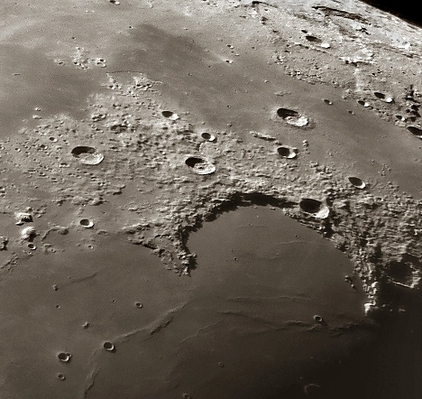
STATION #2
Bay of Rainbows & Sea of Showers
Sea of Cold
Mare Imbrium = Sea of Showers
Elliptical plain 670 by 750 miles
Sinus Iridum = Bay of Rainbows
Circular crater 160 miles across
Bay of
Rainbows
Sea of Showers

Slide 11
Harpalus
Marian
Sharp
Bianchini
Jura Mts
Cape Heraclides
Cape Laplace

Slide 12
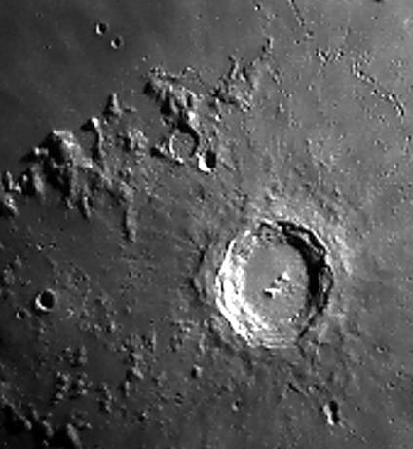
STATION #3
Copernicus (the young) & the Carpathian Mts (the old)
Copernicus
60 miles across – 12,600 ft rim
Central Peaks – 2,000 ft
Conspicuous rays & secondary craters & terraced walls
Very Young – 1 billion years
Carpathian Mts
Formed from the Imbrian basin impact
Very old 3.9 – 4.3 billion years

Slide 13
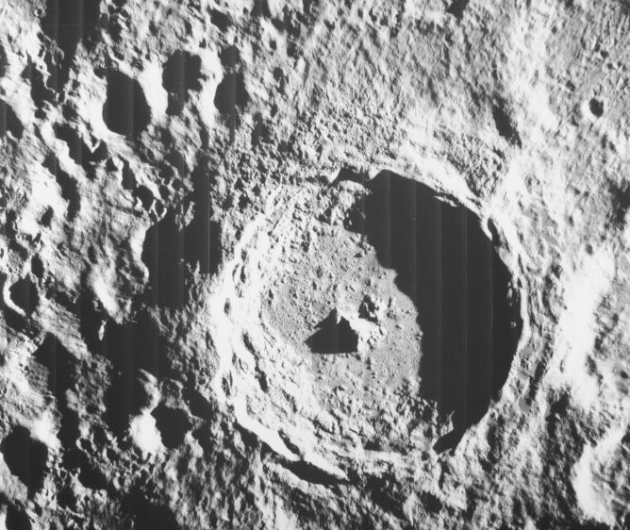
STATION #4
Tycho and its Rays
56 miles across – rim 13,800 ft
Central Peak 5,200 ft
Youngest of the Prominent Craters
500 million years old
When moon is full Tycho is surrounded by a dusky ring (nimbus)
Rays are feather-like splashes of crushed rock derived chiefly from the impact of individual large fragments or clusters of fragments

Slide 14
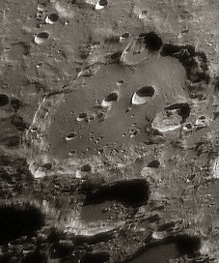
STATION #5
Clavius
132 miles by 152 miles
One of the largest walled plains (craters to big to have rebound peaks) – so large that the curvature of the moon makes the center higher than the rim – at sunrise the light hits the floor of the crater before the edges.
Very old
Note inter arch of descending sized craters

Slide 15
STATION #6
The Seas of Crises, Fertility, Tranquility & Serenity
Mare Serenitatis = Sea of Serenity
Mare Crisium = Sea of Crises
Mare Tranquillitatis = Sea of Tranquility
Mare Fecunditatis = Sea of Fertility

Slide 16
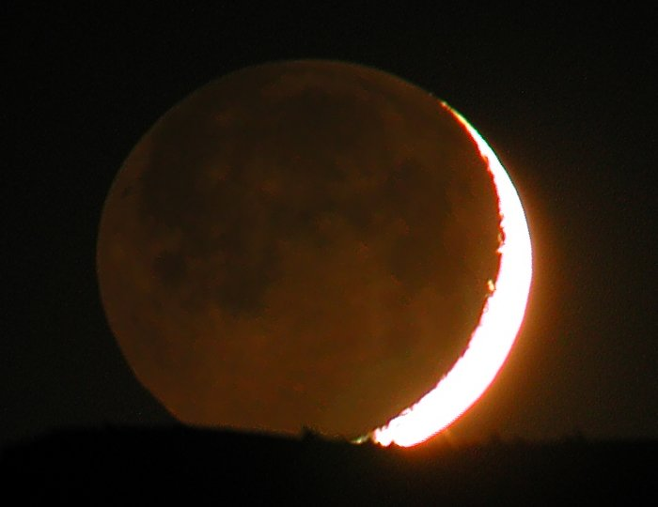
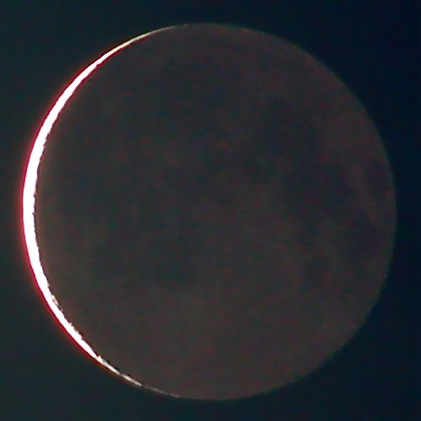
THANKS FOR COMING
Old moon in new moon’s arms
2 days 17 hours
New moon in old moon’s arms
28 days 2 hours

